Slide 1
COMS 4111: Introduction to Databases Lecture 20: Transactions (II), Database Applications (II)
Dr. Donald F. Ferguson
dff9@columbia.edu

Slide 2
Query Optimization and Statistics

Slide 3
Statistics and Optimization

Slide 4
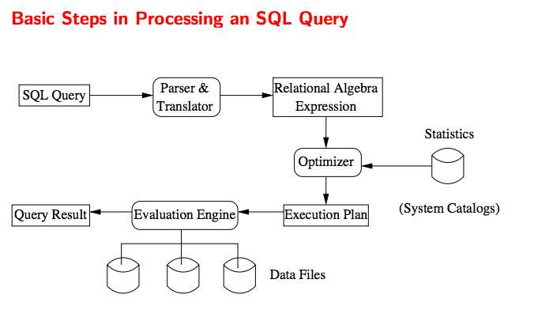
Basic Steps

Slide 5
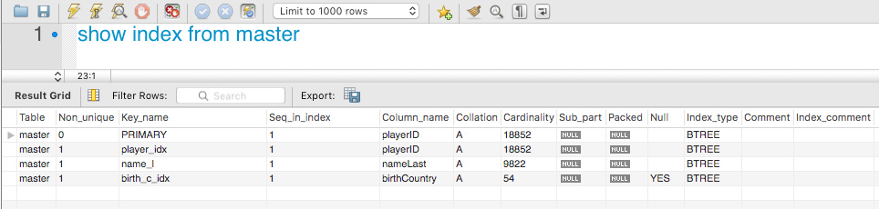
Index Selectivity
Consider the query
SELECT * FROM Master WHERE nameLast=“Williams” and birthCountry=“USA”
Using nameLast for the access path and then scanning for birthCountry=USA will examine approx. #(Master)/9822 tuples.
Using birthCountry for the access path and then scanning for nameLast=“Williams” will examine approx. #(Master)/54 tuples

Slide 6
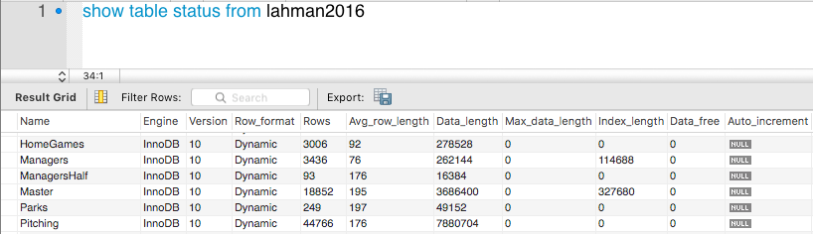
Table Statistics
Consider joining Manager and Master on a non-clustered index.
Master has many more tuples, which would imply that I would want to use the index on Master and get complexity O(#(Managers)*Log(#Master))
But, the index is not clustered, which means that I would be randomly accessing the index block and data block.
A better plan might be:
Completely load the smaller Managers table into memory.
Go through the Master table one block at a time.
The number of tuples comparison will be #(Master)*#(Managers)
But the number of I/Os will be minimum: the query loads each block one tim,e.

Slide 7
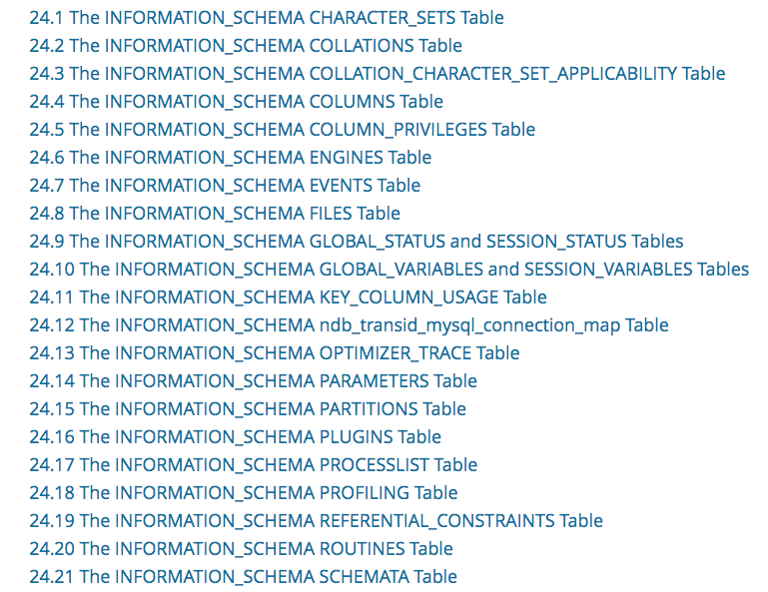
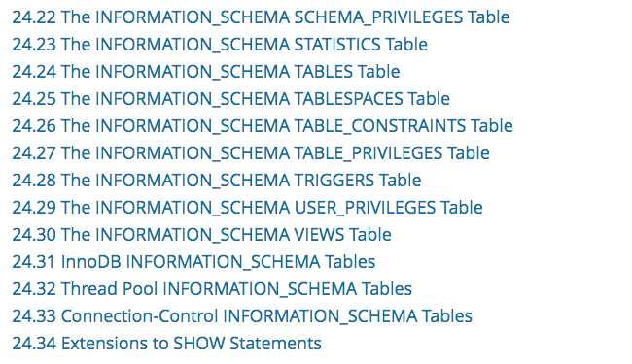
MySQL Information
Other engines have similar metadata that enables statistics based query optimization.

Slide 8
Algorithm Example –

Slide 9
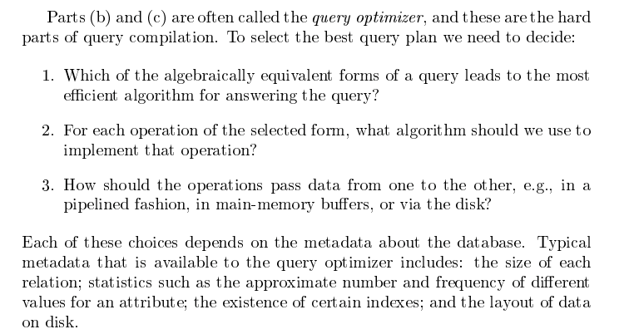
Query Processing (Continued)

Slide 10
Hash JOINs
Problem
R Equi-JOIN S
R, S are large
Non-Index
JOINs are
Scan R
Probe S for each R.t
Non-index ➔ Scan S
If
S is B blocks and R is C blocks
Memory space for S is k < B blocks
Each probe is (B-k) block reads
Read I/O cost is #(R)*(B-k)
If the algorithm hashes S and R
O(B + C) reads to hash and load partitions.
Once to partition; once to load.
No I/Os during Scan/Probe.

Slide 11
SELECT DISTINCT
The basic algorithm is for t in R: if t matches condition: for m in result: if t == m: break else result.append(m)
If there are very few duplicates, #(result) ≅ #(R).
If R is large, result is large.
If B(result) is the number of blocks and k is the number that fit in memory, the scans of result require O(#(R)*(B(results)-k) I/O.
If the algorithm partitions R and result, reads are O(B(R) + B(result))

Slide 12
Introduction

Slide 13
What is happening?
A Data Definition Statement Defines or “Creates” a definition/type of data, which is needed for DML.
“Client” App 1
Connection
DDL Statement
“Client” App 2
Database
Management
System
(Instance)
“Client” App …
DML Statement
A Data Manipulation Statement Creates, Retrieves, Updates or Deletes Data.

Slide 14
Web/Internet Application (Example)
Accounts
Products
User profiles
Registrations
Course schedule
etc.
Machine D – Database Server
Devices
Other Corporations’ Apps
HTML JPG, MPG JavaScript CSS etc.
There are 100s, 1000s, millions of simultaneous user sessions.
There may be 100s, 1000s of servers at each tier to achieve
Scalability (throughput, response time)
Availability, fault tolerance.
Servers may be spread over multiple data centers, public/private clouds, etc.

Slide 15
More Complex, but Simple Cloud Example

Slide 16
Concurrent Execution

Slide 17
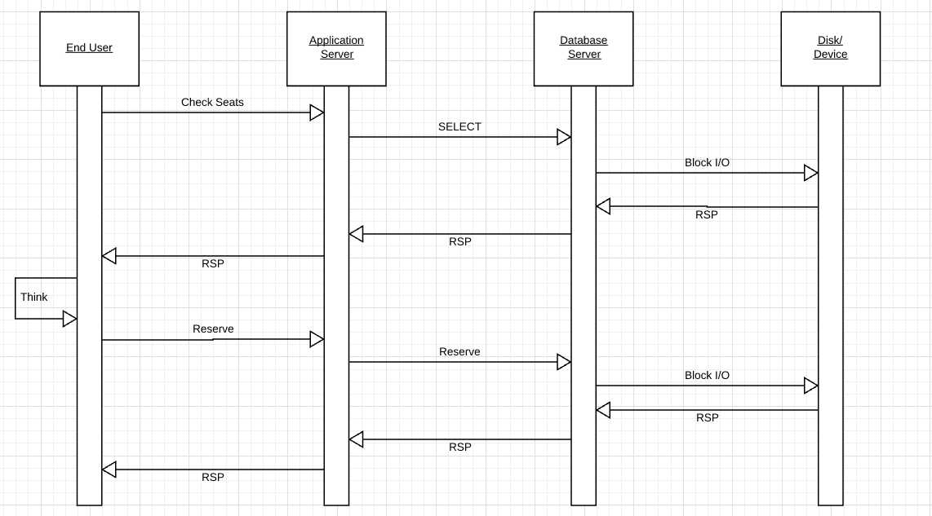
Typical Interaction Operation Choose a Seat

Slide 18
Typical Interaction Operation Choose a Seat
What does the DB server CPU do while waiting? Remember, I/O takes forever from a CPUs perspective.
What happens while the user thinks, which is eons for a CPU? Can anyone else book seats?

Slide 19
Some Terms
“In computing, multitasking is a concept of performing multiple tasks (also known as processes) over a certain period of time by executing them concurrently. New tasks start and interrupt already started ones before they have reached completion, instead of executing the tasks sequentially so each started task needs to reach its end before a new one is started. As a result, a computer executes segments of multiple tasks in an interleaved manner, while the tasks share common processing resources such as central processing units (CPUs) and main memory.”
“In multiprogramming systems, the running task keeps running until it performs an operation that requires waiting for an external event (e.g. reading from a disk or tape, receiving a message from a network, reading from a terminal or other human input device) or until the computer's scheduler forcibly swaps the running task out of the CPU. Multiprogramming systems are designed to maximize CPU usage.”
“Multithreading
As multitasking greatly improved the throughput of computers, programmers started to implement applications as sets of cooperating processes (e. g., one process gathering input data, one process processing input data, one process writing out results on disk). This, however, required some tools to allow processes to efficiently exchange data.^{[citation needed]}
Threads were born from the idea that the most efficient way for cooperating processes to exchange data would be to share their entire memory space. Thus, threads are effectively processes that run in the same memory context and share other resources with their parent processes, such as open files. Threads are described as lightweight processes because switching between threads does not involve changing the memory context.”

Slide 20
Some Terms
“In computing, multitasking is a concept of performing multiple tasks (also known as processes) over a certain period of time by executing them concurrently. New tasks start and interrupt already started ones before they have reached completion, instead of executing the tasks sequentially so each started task needs to reach its end before a new one is started. As a result, a computer executes segments of multiple tasks in an interleaved manner, while the tasks share common processing resources such as central processing units (CPUs) and main memory.”
“In multiprogramming systems, the running task keeps running until it performs an operation that requires waiting for an external event (e.g. reading from a disk or tape, receiving a message from a network, reading from a terminal or other human input device) or until the computer's scheduler forcibly swaps the running task out of the CPU. Multiprogramming systems are designed to maximize CPU usage.”
“Multithreading
As multitasking greatly improved the throughput of computers, programmers started to implement applications as sets of cooperating processes (e. g., one process gathering input data, one process processing input data, one process writing out results on disk). This, however, required some tools to allow processes to efficiently exchange data.^{[citation needed]}
Threads were born from the idea that the most efficient way for cooperating processes to exchange data would be to share their entire memory space. Thus, threads are effectively processes that run in the same memory context and share other resources with their parent processes, such as open files. Threads are described as lightweight processes because switching between threads does not involve changing the memory context.”
Overly simplistically,
The database server is an operating system process, and competes with other processes for CPU, memory, etc.
The database server is internally multithreaded and processes multiple query operations, swapping between threads when there is a buffer miss (block I/O required).

Slide 21
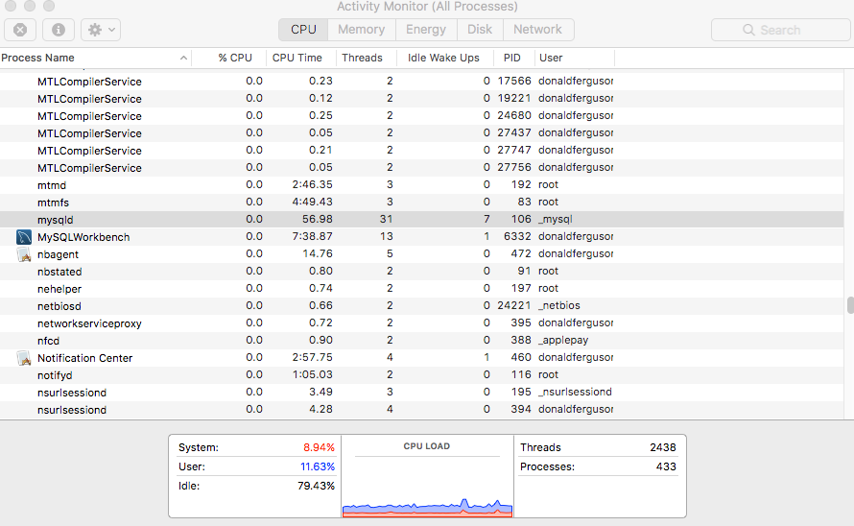
An Example
Obviously, on a dedicated HW or virtual server
The database server does not compete for resources with
Word
Eclipse
Chrome
etc.
But, will compete with
Background OS tasks.
Security monitoring SW
Admin SW
etc.
Use internal multithreading, which is much more efficient than OS level process switching.

Slide 22
Transactions

Slide 23
Core Transaction Concept is ACID Properties (http://slideplayer.com/slide/9307681/)
ACID
Atomic
“ALL OR NOTHING”
Transaction cannot be subdivided
Consistent
Transaction → transform database from one consistent state to another consistent state
Isolated
Transactions execute independently of one another
Database changes not revealed to users until after transaction has completed
Durable
Database changes are permanent
The permanence of the database’s consistent state

Slide 24
ACID Properties (https://www.tutorialspoint.com/dbms/dbms_transaction.htm)
A transaction is a very small unit of a program and it may contain several low-level tasks. A transaction in a database system must maintain Atomicity, Consistency, Isolation, and Durability − commonly known as ACID properties − in order to ensure accuracy, completeness, and data integrity.
Atomicity − This property states that a transaction must be treated as an atomic unit, that is, either all of its operations are executed or none. There must be no state in a database where a transaction is left partially completed. States should be defined either before the execution of the transaction or after the execution/abortion/failure of the transaction.
Consistency − The database must remain in a consistent state after any transaction. No transaction should have any adverse effect on the data residing in the database. If the database was in a consistent state before the execution of a transaction, it must remain consistent after the execution of the transaction as well.
Durability − The database should be durable enough to hold all its latest updates even if the system fails or restarts. If a transaction updates a chunk of data in a database and commits, then the database will hold the modified data. If a transaction commits but the system fails before the data could be written on to the disk, then that data will be updated once the system springs back into action.
Isolation − In a database system where more than one transaction are being executed simultaneously and in parallel, the property of isolation states that all the transactions will be carried out and executed as if it is the only transaction in the system. No transaction will affect the existence of any other transaction.

Slide 25
Atomicity

Slide 26
Atomicity
A transaction is a logical unit of work that must be either entirely completed or entirely undone. (All writes happen or none of them happen)
OK. What does this mean? Consider extra-credit project 3.
stored procedure transfer(source_acct_id, target_acct_id, amount)
Check that both accounts exist.
IF is_checking_account
Check that (source_acct.balance-amount) > source_account.overdraft_limit
ELSE
Check that (source_count.balance-amount) >source_account.minimum_balance
Update source account
Update target account.
INSERT a record into transfer tracking table.

Slide 27
Atomicity
A transaction is a logical unit of work that must be either entirely completed or entirely undone. (All writes happen or none of them happen)
OK. What does this mean? Consider extra-credit project 3.
stored procedure transfer(source_acct_id, target_acct_id, amount)
Check that both accounts exist.
IF is_checking_account
Check that (source_acct.balance-amount) > source_account.overdraft_limit
ELSE
Check that (source_count.balance-amount) >source_account.minimum_balance
Update source account
Update target account.
INSERT a record into transfer tracking table.
Computer or DB Server fails.

Slide 28
Atomicity
OK. That stored procedure runs in milliseconds. What are the chances of the failure occurring there?
Well, that doesn’t really matter. If it happens,
Someone lost money and
There is no record off it. Someone is going to very upset.
Even a small server can have thousands of concurrent transactions ➔
There will be corruptions because some transaction will be in the wrong place at the wrong time.
Unless we do something in the DBMS
Because HW and software inevitably fail
And sadly, SW is especially prone to failure when under load

Slide 29
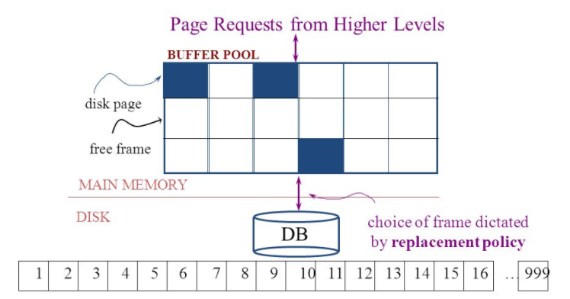
Simplistic Approach
Begin
Update A
Update B
Update C
Commit (REQ)
Force to disk
Commit (RSP)

Slide 30
Simplistic Approach
There are several problems with the simplistic approach.
The approach does not solve the problem
Some write might succeed.
Some might be interrupted by the failure, or require retry.
Writes may be random and scattered. N updates might
Change a few bytes in N data frames
A few bytes in M index frames
Transaction rate becomes bottlenecked by write I/O rate, even though a relative small number of bytes change/transaction.
Written frames must be held in memory.
Lots of transactions
Randomly writing small pieces of lots of frames.
Consumes lots of memory with pinned pages.
Degrades the performance and optimization of the buffer.
The optimal buffer replacement policy wants to hold frames that will be reused.
Not frames that have been touched and never reused.

Slide 31
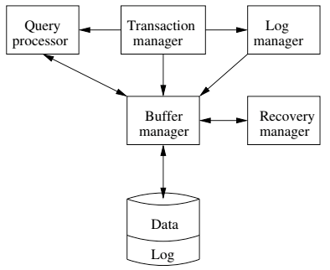
DBMS ACID Implementation
Implementation Subsystems
Query processor schedules and executes queries.
Buffer manager controls reading/writing blocks/frames to/from disk.
Log manager journals/records events to disk (log), e.g.
Transaction start/commit/abort
Transaction update of a block and previous value of data.
Transaction manager coordinates query scheduling, buffer read/write and logging to ensure ACID.
Recovery manager processes log to ensure ACID even after transaction or system failures.
Log is a special type of block file used by the system to optimize performance and ensure ACID.
Garcia-Molina et al., p. 846

Slide 32
Logging
The DBMS logs every transaction event
Log Sequence Number (LSN): A unique ID for a log record.
Prev LSN: A link to their last log record.
Transaction ID number.
Type: Describes the type of database log record.
Update Log Record
PageID: A reference to the Page ID of the modified page.
Length and Offset: Length in bytes and offset of the page are usually included.
Before and After Images of records.
Compensation Log Record
Commit Record
Abort Record Checkpoint Record
Completion Record notes that all work has been done for this particular transaction.

Slide 33
Write Ahead Logging
DBMS (Redo processing)
Write log events from all transactions into a single log stream.
Multiple events per page
Forces (writes) log record on COMMIT/ABORT
Single block I/O records many updates
Versus multiple block I/Os, each recording a single change.
All of a transaction’s updates recorded in one I/O versus many.
If there is a failure
DBMS sequentially reads log.
Applies changes to modified pages that were not saved to disk.
Then resumes normal processing.
Begin
Update A
Update B
Update C
Commit (REQ)
Force to disk
Commit (RSP)
Log

Slide 34
Write Ahead Logging
DBMS (Undo processing)
Enable steal policy to improve cache performance by
Avoiding lots of pinned pages
Unlikely to be reused soon.
Before stealing
Force log record to disk.
Update log entry has data record
Before image
After image
If there is a failure
DBMS sequentially reads log.
Undoes changes to
modified pages, uncommitted pages
That were saved to disk.
Then resumes normal processing.
Force every write to disk?
Poor response time.
But provides durability.
Steal buffer-pool frames from uncommitted transactions?
If not, poor performance/caching performance
If yes, how can we ensure atomicity? Uncommitted updates on disk
No Steal
Steal
Force
Trivial
No Force
Desired

Slide 35
ARIES Algorithm = Algorithms for Recovery and Isolation Exploiting Semantics
ARIES recovery involves three passes
Analysis pass:
Determine which transactions to undo
Determine which pages were dirty (disk version not up to date) at time of
RedoLSN: LSN from which redo should start
Redo pass:
Repeats history, redoing all actions from RedoLSN (updated committed but not written changes to pages)
RecLSN and PageLSNs are used to avoid redoing actions already reflected on page
Undo pass:
Rolls back all incomplete transactions (with uncommitted pages written to disk).
Transactions whose abort was complete earlier are not undone

Slide 36
Durability

Slide 37
Durability
Write changes to disk trivially achieves durability.
DBMS engine uses write-ahead-logging to
Achieve durability
But with better performance through more efficient caching and I/O.
Well, disks fail. How is that durable.
RAID and other solutions.
Disk subsystems, including entire RAID device, fail →
Duplex writes
To independent disk subsystems.
Well, there are earthquakes, floods, etc.

Slide 38
Availability and Replication
There are two basic patterns
Active/Passive
All requests go to master during normal processing.
Updates are transactionally queued for processing at passive backup.
Failure of master
Routes subsequent requests to backup.
Backup must process and commit updates before accepting requests.
Active/Active
Both environments process requests.
Some form of distributed transaction commit required to synchronize updates on both copies.
Multi-system communication to guarantee consistency is the foundation for tradeoffs in CAP.
The system can be CAP if and only iff
There are never any partitions or system failures
Which is unrealistic in cloud/Internet systems.

Slide 39
Isolation

Slide 40
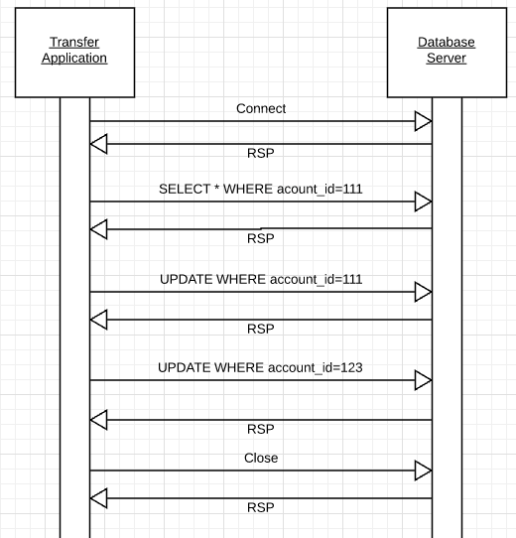
Transfer Funds
Transfer $50 from
account_id=111 to
account_id=123
Requires 3 SQL statements
SELECT from 111 to check balance >= $50
UPDATE account_id=111
UPDATE account_id=123
There are some interesting scenarios
Two different programs read the balance ($51)
And decide removing $50 is OK.
DB constraints can prevent the conflict from happening, but …
There are more complex scenarios that constraints do not prevent.
Not ALL databases support constraints.
The “correct” execution should be that
One transaction responds “insufficient funds”
Before attempting transfer instead of after attempting.
Multiple readers

Slide 41
Transfer Funds
Consider two simultaneous transfer transactions T1 and T2.
There are two equally correct executions
T1 transfers, T2 responds “insufficient funds” and does not attempt transfer
T2 transfers, T1 responds “insufficient funds” and does not attempt transfer
Each correct simultaneous execution is equivalent to a serial (sequential) execution schedule
(1) Execute T1, Execute T2
(2) Execute T2, Execute T1
NOTE:
We are focusing on correctness not
Fairness:
We do not care which transaction was actually submitted first.
And probably do not know due to networking, etc.
Transfer $50 from
account_id=111 to
account_id=123
Requires 3 SQL statements
SELECT from 111 to check balance >= $50
UPDATE account_id=111
UPDATE account_id=123
There are some interesting scenarios
Two different programs read the balance ($51)
And decide removing $50 is OK.
DB constraints can prevent the conflict from happening, but …
There are more complex scenarios that constraints do not prevent.
Not ALL databases support constraints.
The “correct” execution should be that
One transaction responds “insufficient funds”
Before attempting transfer instead of after attempting.
Multiple readers

Slide 42
Serializability
“In concurrency control of databases,^{[1][2]} transaction processing (transaction management), and various transactional applications (e.g., transactional memory^{[3]} and software transactional memory), both centralized and distributed, a transaction schedule is serializable if its outcome (e.g., the resulting database state) is equal to the outcome of its transactions executed serially, i.e. without overlapping in time. Transactions are normally executed concurrently (they overlap), since this is the most efficient way. Serializability is the major correctness criterion for concurrent transactions' executions. It is considered the highest level of isolation between transactions, and plays an essential role in concurrency control. As such it is supported in all general purpose database systems.” (https://en.wikipedia.org/wiki/Serializability)

Slide 43
DBMS ACID Implementation
Implementation Subsystems
Query processor schedules and executes queries.
Buffer manager controls reading/writing blocks/frames to/from disk.
Log manager journals/records events to disk (log), e.g.
Transaction start/commit/abort
Transaction update of a block and previous value of data.
Transaction manager coordinates query scheduling, buffer read/write and logging to ensure ACID.
Recovery manager processes log to ensure ACID even after transaction or system failures.
Log is a special type of block file used by the system to optimize performance and ensure ACID.
Garcia-Molina et al., p. 846

Slide 44
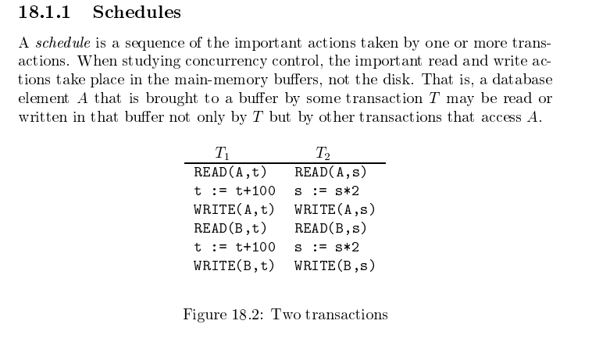
Schedule
Garcia-Molina et al.

Slide 45
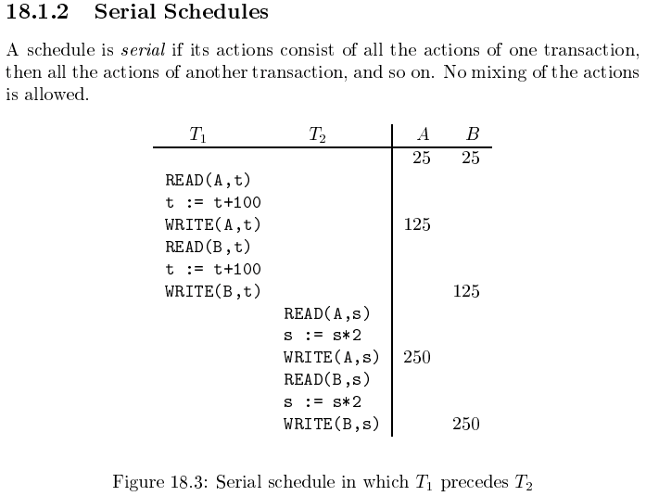
Serializable
Assume there are three
concurrently executing transactions
T1, T2 and T3
The transaction manager
Enables concurrent execution
But schedules individual operations
To ensure that the final DB state
Is equivalent to one of the following schedules
T1, T2, T3
T1, T3, T2
T2, T1, T3
T2, T3, T1
T3, T1, T2
T3, T2, T1
Concurrent execution was serializable.

Slide 46
Serializability (https://en.wikipedia.org/wiki/Serializability)
Serializability is used to keep the data in the data item in a consistent state. Serializability is a property of a transaction schedule (history). It relates to the isolation property of a database transaction.
Serializability of a schedule means equivalence (in the outcome, the database state, data values) to a serial schedule (i.e., sequential with no transaction overlap in time) with the same transactions. It is the major criterion for the correctness of concurrent transactions' schedule, and thus supported in all general purpose database systems.
The rationale behind serializability is the following:
If each transaction is correct by itself, i.e., meets certain integrity conditions,
then a schedule that comprises any serial execution of these transactions is correct (its transactions still meet their conditions):
"Serial" means that transactions do not overlap in time and cannot interfere with each other, i.e, complete isolation between each other exists.
Any order of the transactions is legitimate, (…)
As a result, a schedule that comprises any execution (not necessarily serial) that is equivalent (in its outcome) to any serial execution of these transactions, is correct.

Slide 47
Lock-Based Concurrency Control
Strict Two-phase Locking (Strict 2PL) Protocol:
Each Xact must obtain a S (shared) lock on object before reading, and an X (exclusive) lock on object before writing.
All locks held by a transaction are released when the transaction completes
(Non-strict) 2PL Variant: Release locks anytime, but cannot acquire locks after releasing any lock.
If an Xact holds an X lock on an object, no other Xact can get a lock (S or X) on that object.
Strict 2PL allows only serializable schedules.
Additionally, it simplifies transaction aborts
(Non-strict) 2PL also allows only serializable schedules, but involves more complex abort processing

Slide 48
Aborting a Transaction
If a transaction Ti is aborted, all its actions have to be undone. Not only that, if Tj reads an object last written by Ti, Tj must be aborted as well!
Most systems avoid such cascading aborts by releasing a transaction’s locks only at commit time.
If Ti writes an object, Tj can read this only after Ti commits.
In order to undo the actions of an aborted transaction, the DBMS maintains a log in which every write is recorded. This mechanism is also used to recover from system crashes: all active Xacts at the time of the crash are aborted when the system comes back up.

Slide 49
Locking
Transaction Manager
Intercepts all database operations.
Acquires/checks locks on
Records
Pages
Index pages
Suspends and queues an operation
In another active, executing op.
Has a conflicting lock.
Restarts queued operations when conflicting locks are released.
Garcia-Molina et al., p. 846

Slide 50
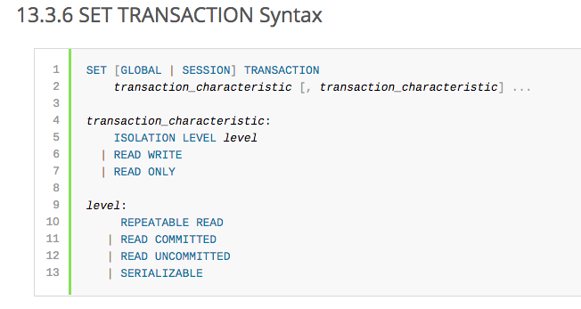
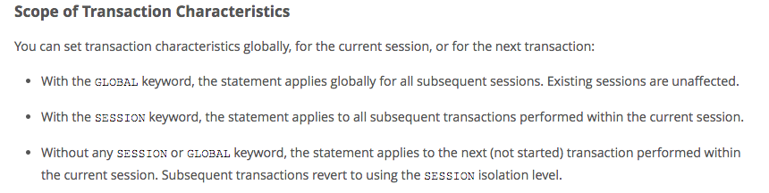
MySQL (Locking) Isolation

Slide 51
Demo

Slide 52
Isolation Levels (https://en.wikipedia.org/wiki/Isolation_(database_systems)
Not all transaction use cases require 2PL and serializable execution. Databases support a a set of levels.
Serializable
With a lock-based concurrency control DBMS implementation, serializability requires read and write locks (acquired on selected data) to be released at the end of the transaction. Also range-locks must be acquired when a SELECT query uses a ranged WHERE clause, especially to avoid the phantom reads phenomenon.
The execution of concurrent SQL-transactions at isolation level SERIALIZABLE is guaranteed to be serializable. A serializable execution is defined to be an execution of the operations of concurrently executing SQL-transactions that produces the same effect as some serial execution of those same SQL-transactions. A serial execution is one in which each SQL-transaction executes to completion before the next SQL-transaction begins.
Repeatable reads[edit]
In this isolation level, a lock-based concurrency control DBMS implementation keeps read and write locks (acquired on selected data) until the end of the transaction. However, range-locks are not managed, so phantom reads can occur.
Write skew is possible at this isolation level, a phenomenon where two writes are allowed to the same column(s) in a table by two different writers (who have previously read the columns they are updating), resulting in the column having data that is a mix of the two transactions.^{[3][4]}
Read committed[edit]
In this isolation level, a lock-based concurrency control DBMS implementation keeps write locks (acquired on selected data) until the end of the transaction, but read locks are released as soon as the SELECT operation is performed (so the non-repeatable reads phenomenon can occur in this isolation level). As in the previous level, range-locks are not managed.
Putting it in simpler words, read committed is an isolation level that guarantees that any data read is committed at the moment it is read. It simply restricts the reader from seeing any intermediate, uncommitted, 'dirty' read. It makes no promise whatsoever that if the transaction re-issues the read, it will find the same data; data is free to change after it is read.
Read uncommitted[edit]
This is the lowest isolation level. In this level, dirty reads are allowed, so one transaction may see not-yet-committed changes made by other transactions

Slide 53
Book Slides

Slide 54
Transactions
Concurrent execution of user programs is essential for good DBMS performance.
Because disk accesses are frequent, and relatively slow, it is important to keep the cpu humming by working on several user programs concurrently.
A user’s program may carry out many operations on the data retrieved from the database, but the DBMS is only concerned about what data is read/written from/to the database.
A transaction is the DBMS’s abstract view of a user program: a sequence of reads and writes.

Slide 55
Concurrency in a DBMS
Users submit transactions, and can think of each transaction as executing by itself.
Concurrency is achieved by the DBMS, which interleaves actions (reads/writes of DB objects) of various transactions.
Each transaction must leave the database in a consistent state if the DB is consistent when the transaction begins.
DBMS will enforce some ICs, depending on the ICs declared in CREATE TABLE statements.
Beyond this, the DBMS does not really understand the semantics of the data. (e.g., it does not understand how the interest on a bank account is computed).
Issues: Effect of interleaving transactions, and crashes.

Slide 56
Atomicity of Transactions
A transaction might commit after completing all its actions, or it could abort (or be aborted by the DBMS) after executing some actions.
A very important property guaranteed by the DBMS for all transactions is that they are atomic. That is, a user can think of a Xact as always executing all its actions in one step, or not executing any actions at all.
DBMS logs all actions so that it can undo the actions of aborted transactions.

Slide 57
Example
Consider two transactions (Xacts):
T1: BEGIN A=A+100, B=B-100 END
T2: BEGIN A=1.06*A, B=1.06*B END
Intuitively, the first transaction is transferring $100 from B’s account to A’s account. The second is crediting both accounts with a 6% interest payment.
There is no guarantee that T1 will execute before T2 or vice-versa, if both are submitted together. However, the net effect must be equivalent to these two transactions running serially in some order.

Slide 58
Example (Contd.)
Consider a possible interleaving (schedule):
T1: A=A+100, B=B-100
T2: A=1.06*A, B=1.06*B
This is OK. But what about:
T1: A=A+100, B=B-100
T2: A=1.06*A, B=1.06*B
The DBMS’s view of the second schedule:
T1: R(A), W(A), R(B), W(B)
T2: R(A), W(A), R(B), W(B)

Slide 59
Scheduling Transactions
Serial schedule: Schedule that does not interleave the actions of different transactions.
Equivalent schedules: For any database state, the effect (on the set of objects in the database) of executing the first schedule is identical to the effect of executing the second schedule.
Serializable schedule: A schedule that is equivalent to some serial execution of the transactions.
(Note: If each transaction preserves consistency, every serializable schedule preserves consistency. )

Slide 60
Anomalies with Interleaved Execution
Reading Uncommitted Data (WR Conflicts, “dirty reads”):
Unrepeatable Reads (RW Conflicts):
T1: R(A), W(A), R(B), W(B), Abort
T2: R(A), W(A), C
T1: R(A), R(A), W(A), C
T2: R(A), W(A), C

Slide 61
Anomalies (Continued)
Overwriting Uncommitted Data (WW Conflicts):
T1: W(A), W(B), C
T2: W(A), W(B), C

Slide 62
Lock-Based Concurrency Control
Strict Two-phase Locking (Strict 2PL) Protocol:
Each Xact must obtain a S (shared) lock on object before reading, and an X (exclusive) lock on object before writing.
All locks held by a transaction are released when the transaction completes
(Non-strict) 2PL Variant: Release locks anytime, but cannot acquire locks after releasing any lock.
If an Xact holds an X lock on an object, no other Xact can get a lock (S or X) on that object.
Strict 2PL allows only serializable schedules.
Additionally, it simplifies transaction aborts
(Non-strict) 2PL also allows only serializable schedules, but involves more complex abort processing

Slide 63
Aborting a Transaction
If a transaction Ti is aborted, all its actions have to be undone. Not only that, if Tj reads an object last written by Ti, Tj must be aborted as well!
Most systems avoid such cascading aborts by releasing a transaction’s locks only at commit time.
If Ti writes an object, Tj can read this only after Ti commits.
In order to undo the actions of an aborted transaction, the DBMS maintains a log in which every write is recorded. This mechanism is also used to recover from system crashes: all active Xacts at the time of the crash are aborted when the system comes back up.

Slide 64
The Log
The following actions are recorded in the log:
Ti writes an object: the old value and the new value.
Log record must go to disk before the changed page!
Ti commits/aborts: a log record indicating this action.
Log records are chained together by Xact id, so it’s easy to undo a specific Xact.
Log is often duplexed and archived on stable storage.
All log related activities (and in fact, all CC related activities such as lock/unlock, dealing with deadlocks etc.) are handled transparently by the DBMS.

Slide 65
Recovering From a Crash
There are 3 phases in the Aries recovery algorithm:
Analysis: Scan the log forward (from the most recent checkpoint) to identify all Xacts that were active, and all dirty pages in the buffer pool at the time of the crash.
Redo: Redoes all updates to dirty pages in the buffer pool, as needed, to ensure that all logged updates are in fact carried out and written to disk.
Undo: The writes of all Xacts that were active at the crash are undone (by restoring the before value of the update, which is in the log record for the update), working backwards in the log. (Some care must be taken to handle the case of a crash occurring during the recovery process!)

Slide 66
Summary
Concurrency control and recovery are among the most important functions provided by a DBMS.
Users need not worry about concurrency.
System automatically inserts lock/unlock requests and schedules actions of different Xacts in such a way as to ensure that the resulting execution is equivalent to executing the Xacts one after the other in some order.
Write-ahead logging (WAL) is used to undo the actions of aborted transactions and to restore the system to a consistent state after a crash.
Consistent state: Only the effects of commited Xacts seen.

Slide 67
REST Implications

Slide 68
Read then Update Conflict
Some
Resource
1. Bob GETs the resource.
3. Bob changes the data based on values.
2. Mary GETs the resource.
If
The written value
Depends on the read value.
The resource may be in the wrong state and the end.
The execution was RRWW
But the intent was RWRW.
4. Mary changes the data based on values.

Slide 69
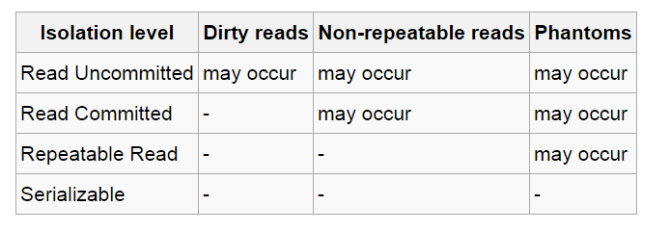
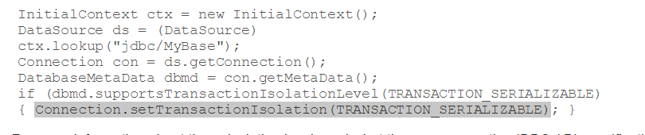
In Databases, Cursors Define Isolation
We have talked about ACID transactions
Atomic: A set of writes all occur or none occur.
Durable: The data “does not disappear,” e.g. write to disk.
Consistent: My applications move the database between consistent states, e.g. the transfer function works correctly.
Isolation
Determines what happens when two or more threads are manipulating the data at the same time.
And is defined relative to where cursors are and what they have touched.
Because the cursor movement determines what you are reading or have read.
But, … Cursors are client conversation state and cannot be used in REST.

Slide 70
Isolation/Concurrency Control
There are two basic approaches to implementing isolation
Locking/Pessimistic, e.g. cursor isolation
Optimistic: Before committing, each transaction verifies that no other transaction has modified the data it has read.
How does this work in REST?
The server maintains an ETag (Entity Tag) for each resource.
Every time a resource’s state changes, the server computes a new ETag.
The server includes the ETag in the header when returning data to the client.
The server may optionally maintain and return “Last Modified” time for resources.
Semantics on updates
If-Match – value of a previous calls ETag response used with a PUT or DELETE. Server should only act if nobody else has modified the resource since you last fetched it. Otherwise provides a 412.
If-Modified-Since – value of a previous Last-Modified response used with a GET. Server should only provide a response if the resource was modified since the timestamp submitted. Use in conjunction with If-None-Match in case the change occurred within the same second. Otherwise provide a 304.
If-None-Match – value of a previous calls ETag response used with a GET. Server should only provide a response if the ETag doesn’t match, i.e. the resource has been altered. Otherwise provide a 304.
If-Unmodified-Since – value of a previous Last-Modified response used with a PUT or DELETE. Server should only act if nobody else has modified the resource since you last fetched it. Otherwise provides a 412

Slide 71
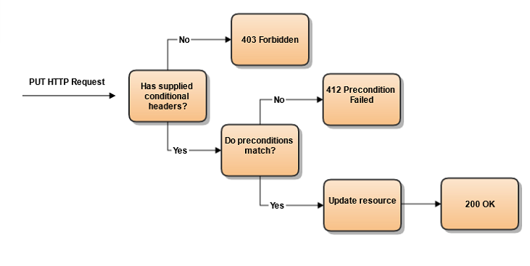
Conditional Processing (https://blog.4psa.com/rest-best-practices-managing-concurrent-updates/)

Slide 72
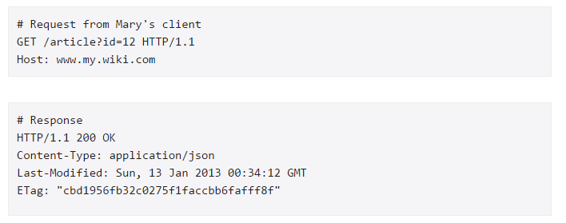
Request/Response

Slide 73
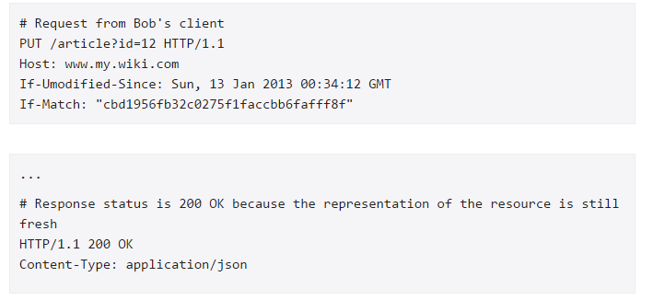
Bob Already Read and now Updates
In addition to updating the resource state, e.g. account balance, this also changes
The ETag
The Last Modified Date

Slide 74
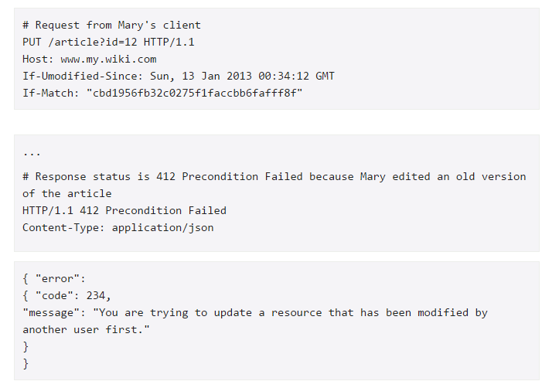
Now Mary Tries to Update
Bob’s update changed the data, and changed this “metadata.”

Slide 75
ETag Processing

Slide 76
Advanced Transaction Presentation

Slide 77
Consistent

Slide 78
And Consistent?
ACID
Atomic
“ALL OR NOTHING”
Transaction cannot be subdivided
Consistent
Transaction → transform database from one consistent state to another consistent state
Isolated
Transactions execute independently of one another
Database changes not revealed to users until after transaction has completed
Durable
Database changes are permanent
The permanence of the database’s consistent state

Slide 79
And Consistent?
Basically, this means
Transaction programs are correct (no bugs).
DBMS enforces isolation.
DBMS does not make a mistake.
ACID
Atomic
“ALL OR NOTHING”
Transaction cannot be subdivided
Consistent
Transaction → transform database from one consistent state to another consistent state
Isolated
Transactions execute independently of one another
Database changes not revealed to users until after transaction has completed
Durable
Database changes are permanent
The permanence of the database’s consistent state

Slide 80
Summary

Slide 81
Summary
We have just skimmed the surface of transactions
Molina et al devotes 150 pages to transaction basics.
Ramakrishnan and Gehrke devote 80 pages to transaction basics.
There are many, many topics that the texts do not cover
Distributed Two-Phase Commit
Sagas, compensation transactions.
Eventual consistency.
Optimistic concurrency control.
Compatible operator concurrency control.
… …
This section provides a foundation for your future work.

Slide 82
What is Next?

Slide 83
CAP Theorem
Consistency
Every read receives the most recent write or an error.
Availability
Every request receives a (non-error) response – without guarantee that it contains the most recent write.
Partition Tolerance
The system continues to operate despite an arbitrary number of messages being dropped (or delayed) by the network between nodes

Slide 84
Core Data Models (http://blog.nahurst.com/visual-guide-to-nosql-systems)
In addition to CAP configurations, another significant way data management systems vary is by the data model they use: relational, key-value, column-oriented, or document-oriented (there are others, but these are the main ones).
Relational systems are the databases we've been using for a while now. RDBMSs and systems that support ACIDity and joins are considered relational.
Key-value systems basically support get, put, and delete operations based on a primary key.
Column-oriented systems still use tables but have no joins (joins must be handled within your application). Obviously, they store data by column as opposed to traditional row-oriented databases. This makes aggregations much easier.
Document-oriented systems store structured "documents" such as JSON or XML but have no joins (joins must be handled within your application). It's very easy to map data from object-oriented software to these systems.

Slide 85
Core Data Models (http://blog.nahurst.com/visual-guide-to-nosql-systems)
In addition to CAP configurations, another significant way data management systems vary is by the data model they use: relational, key-value, column-oriented, or document-oriented (there are others, but these are the main ones).
Relational systems are the databases we've been using for a while now. RDBMSs and systems that support ACIDity and joins are considered relational.
Key-value systems basically support get, put, and delete operations based on a primary key.
Column-oriented systems still use tables but have no joins (joins must be handled within your application). Obviously, they store data by column as opposed to traditional row-oriented databases. This makes aggregations much easier.
Document-oriented systems store structured "documents" such as JSON or XML but have no joins (joins must be handled within your application). It's very easy to map data from object-oriented software to these systems.
There are also graph databases, which we will cover.

Slide 86
Database Models
Consistent, Available (CA) Systems have trouble with partitions and typically deal with it with replication. Examples of CA systems include:
Traditional RDBMSs like Postgres, MySQL, (relational)
Vertica (column-oriented)
Aster Data (relational)
Greenplum (relational)
Consistent, Partition-Tolerant (CP) Systems have trouble with availability while keeping data consistent across partitioned nodes. Examples of CP systems include:
BigTable (column-oriented/tabular)
Hypertable (column-oriented/tabular)
HBase (column-oriented/tabular)
MongoDB (document-oriented)
Terrastore (document-oriented)
Redis (key-value)
Scalaris (key-value)
MemcacheDB (key-value)
Berkeley DB (key-value)
Available, Partition-Tolerant (AP) Systems achieve "eventual consistency" through replication and verification. Examples of AP systems include:
DynamoDB (key-value)
Voldemort (key-value)
Tokyo Cabinet (key-value)
KAI (key-value)
Cassandra (column-oriented/tabular)
CouchDB (document-oriented)
SimpleDB (document-oriented)
Riak (document-oriented)
http://blog.nahurst.com/visual-guide-to-nosql-systems

Slide 87
Database Models
Consistent, Available (CA) Systems have trouble with partitions and typically deal with it with replication. Examples of CA systems include:
Traditional RDBMSs like Postgres, MySQL, (relational)
Vertica (column-oriented)
Aster Data (relational)
Greenplum (relational)
Consistent, Partition-Tolerant (CP) Systems have trouble with availability while keeping data consistent across partitioned nodes. Examples of CP systems include:
BigTable (column-oriented/tabular)
Hypertable (column-oriented/tabular)
HBase (column-oriented/tabular)
MongoDB (document-oriented)
Terrastore (document-oriented)
Redis (key-value)
Scalaris (key-value)
MemcacheDB (key-value)
Berkeley DB (key-value)
Key-Value versus Document can be a little confusing.
Many, if not most, Key-Value stores hold documents.
The difference is
Not in what the data store holds
But how you can query and find it.
Key-Value store finds data by key values explicitly associated with a document.
Document stores allow queries on the fields/values in the document, similar to a relational WHERE on columns.
Available, Partition-Tolerant (AP) Systems achieve "eventual consistency" through replication and verification. Examples of AP systems include:
DynamoDB (key-value)
Voldemort (key-value)
Tokyo Cabinet (key-value)
KAI (key-value)
Cassandra (column-oriented/tabular)
CouchDB (document-oriented)
SimpleDB (document-oriented)
Riak (document-oriented)
http://blog.nahurst.com/visual-guide-to-nosql-systems

Slide 88
Some Queries
MongoDB Query
db.inventory.find( { status: "A", $or: [ { qty: { $lt: 30 } }, { item: /^p/ } ]} )
Finds all documents in the collection wherthe status equals "A" and either qty is less than ($lt) 30 or item starts with the character ”p”
Redis
SADD product:category:1 5 10 // Put product IDs 5 and 10 in category 1.
SMEMBERS product:category:2 // Get the IDs of all products in category 2.
DynamoDB
var params = { TableName : "Movies", KeyConditionExpression: "#yr = :yyyy", ExpressionAttributeNames:{ "#yr": "year" }, ExpressionAttributeValues: { ":yyyy":1985 } };
Dynamo DB
Queries on keys
Scans on values

